Slide 1
XML in C# .NET

Slide 2
Objective
How to work with XML in C# .NET
Reading and processing an XML document
Adding records to an XML document

Slide 3
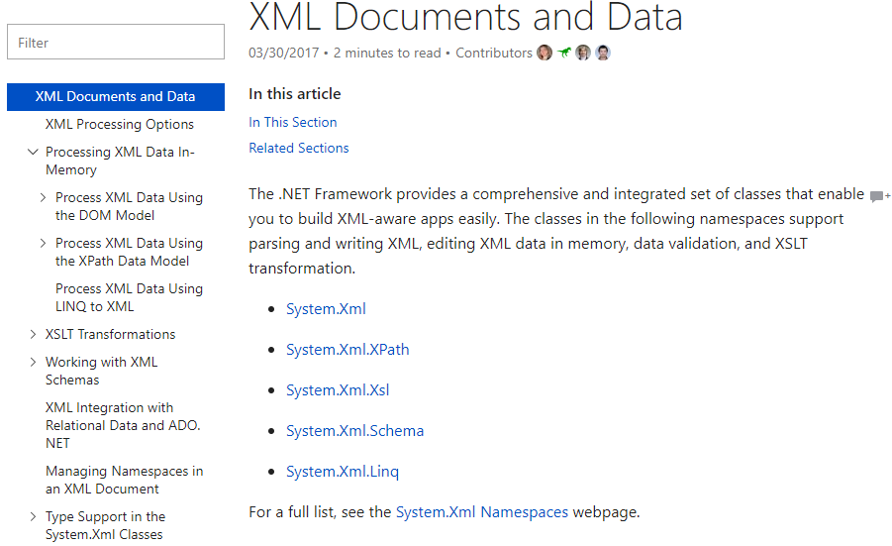
Reference
Microsoft’s XML .NET guide

Slide 4

Different approaches
In Memory
Quick, random access
Read in whole XML into memory and work on it
Limited scaling
Easiest to edit
Stream based
Forward-only reading/writing
Work on one element at a time
Scales up
Notes:
https://docs.microsoft.com/en-us/dotnet/standard/data/xml/xml-processing-options

Slide 5
In memory: Different approaches
XmlDocument
W3C compliant
You can create, insert, remove, and modify nodes by using methods and properties based on the familiar DOM model.
XPathNavigator
Offers several editing options and navigation capabilities using a cursor model.
XML documents can be contained in an XPathDocument or XmlDocument object.
Provides excellent performance for read-only processing of XML.
Use this option if you're modifying existing code with XPath queries or XSLT transformations.
LINQ to XML
Based on the .NET Framework Language-Integrated Query (LINQ) technology.
Provides query experience that is similar to SQL for objects, relational data, and XML data.
Notes:
https://docs.microsoft.com/en-us/dotnet/standard/data/xml/xml-processing-options

Slide 6
Stream based
XmlReader
Provides a fast, non-cached, forward-only way to access XML data.
XmlWriter
Provides a fast, non-cached, forward-only way to generate XML data
Notes:
https://docs.microsoft.com/en-us/dotnet/standard/data/xml/xml-processing-options

Slide 7
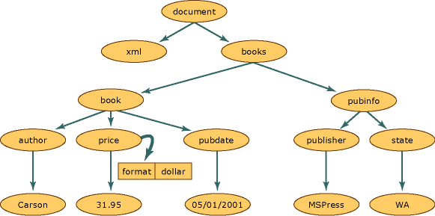
XMLDocument
<?xml version="1.0"?>
<books>
<book>
<author>Carson</author>
<price format="dollar">31.95</price>
<pubdate>05/01/2001</pubdate>
</book>
<pubinfo>
<publisher>MSPress</publisher>
<state>WA</state>
</pubinfo>
</books>
Represents an XML document. Nodes, attributes,..
Nodes have children, parents, siblings
It’s the model you know and have been working on coming from DOM world
Notes:
https://docs.microsoft.com/en-us/dotnet/standard/data/xml/process-xml-data-using-the-dom-model

Slide 8
Reading an XML Document
Create a new XmlDocument object
Use the Load method to load the file
OuterXml is the node and all the children
XmlDocument xd = new XmlDocument();
xd.Load(Server.MapPath("books.xml"));
TextBox1.Text = xd.OuterXml;
Notes:
Show example01

Slide 9
Choosing Specific Elements
XMLNodeList – class representing all the nodes matching a condition
XMLNode – class representing a single node
Can iterate through a node list for each individual node
SelectNodes – a method of the XmlDocument class that matches based on an XPath expression
// for a node
@ for an attribute
/el1/el2/el3 for path from root
Notes:
Show example02 & 03

Slide 10
Iterators
Can loop through the nodes in a selected set of nodes
Create a cursor of class XPathNavigator
Create an iterator of class XPathNodeIterator to iterate over the nodes
Notes:
Show example 04

Slide 11
Using an Iterator
Iterator ->
childIterator->
childIterator->
childIterator->
Iterator ->
childIterator->
childIterator->
childIterator->
<employee id="123" dept="it">
<name>Monica</name>
<hiredate>1997-12-02</hiredate>
<salary>42000.00</salary>
</employee>
<employee id="345" dept="hr">
<name>Joe</name>
<hiredate>1998-11-02</hiredate>
<salary>32000.00</salary>
</employee>
Notes:
Show example 05

Slide 12
Navigating using XmlNode methods
Works like XPath did in JavaScript
Get Node and navigate through children
First Child
Next Sibling
Remember that the root element is the XML tag
Access attributes using the Attributes class of the XmlNode

Slide 13
Navigating using XmlNode methods
xd.FirstChild ->
nd = nd.NextSibling ->
nd = nd.FirstChild ->
nd.NextSibling ->
<?xml version="1.0" encoding="ISO-8859-1"?>
<bookstore>
<book category="cooking"> <title lang="en">Everyday Italian</title> <author>Giada De Laurentiis</author>
<year>2005</year>
<price>30.00</price>
</book>
<book category="children"> <title lang="en">Harry Potter</title> <author>J K. Rowling</author>
<year>2005</year>
<price>29.99</price>
Notes:
Show example06 and 07

Slide 14
Streaming Option: Faster Way to Read XML?
XmlTextReader class can be used to read XML files
Forward only reading (one way through file)
Can test the Node as a Node Type using enumerated field XmlNodeType
Simple ‘Read’ method to read next item in file
Notes:
Show example 08

Slide 15
Streaming option: XmlNodeReader for Navigating
Same idea as TextReader
Create an XmlDocument object
Assign a NodeReader element to the document
Read each node in sequence and process it
Notes:
Show example 09

Slide 16
Validating XML Documents
Can use handlers to validate XML documents to make sure that there are no errors
Create an object of type XmlSchemaSet
Validation can be Schema, DTD or XDR (XML Data Reduced) – subset of XML from Microsoft
Add schema to object
Declare a validation handler to handle exceptions
Automatically called when schema detects an error
Notes:
Show example10

Slide 17
Create XML Document (single node)
Use XmlTextWriter class to write to XML
Various Write Methods to write XML
WriteStartDocument()
WriteStartElement(string)
WriteAttributeString(attr, string)
WriteElementString(element, string)
WriteEndElement() – close last StartElement
WriteEndDocument() – close StartDocument
Notes:
Show example11

Slide 18
Adding to XML Document
First you read the document in
Find out where you want to add it
Can add at a specific position or just add to the end
If want a specific position, find that position

Slide 19
Adding to XML Document
Create an element and all the sub-elements
Append the children to the element
Need to append sub-element name and value separately
Add attributes to correct element/sub-element
If inserting in middle use InsertBefore
If adding to end use AppendChild
Make sure you save the file
Notes:
Show example12

Slide 20
Creating a Dataset from XML
<products>
<product id="100">
<name>Football</name>
<price>50</price>
</product>
<product id="101">
<name>Baseball</name>
<price>15</price>
</product>
<product id="102">
<name>Bat</name>
<price>10</price>
</product>
…

Slide 21
Creating a Dataset from XML
DataSet rData = new DataSet();
rData.ReadXml("~/products.xml")
any attributes are converted to table columns
DataGrid1.DataSource = rData.Tables(0)
the data from the XML file is stored in Tables(0) in the dataset
Or the sub-element of the root
DataGrid1.DataSource = rData.Tables(“product”)
The column names are element names and attribute names (name, price, id)

Slide 22
LINQ to XML
Can be used in-memory or against a file/stream
In-memory interface
Load, query, modify, then save/serialize out
Standardized LINQ syntax (if that’s familiar to you)
Xelement purchaseOrder = Xelement.Load(Server.MapPath("~/App_Data/PurchaseOrder.xml"));
IEnumerable<XElement> partNos =
from item in purchaseOrder.Descendants("Item")
where (int) item.Element("Quantity") *
(decimal) item.Element("USPrice") > 100
orderby (string)item.Element("PartNumber")
select item;
Notes:
http://www.dotnetcurry.com/linq/564/linq-to-xml-tutorials-examples
https://docs.microsoft.com/en-us/dotnet/csharp/programming-guide/concepts/linq/linq-to-xml-overview

Slide 23
LINQ to XML vs DOM
XmlDocument doc = new XmlDocument();
XmlElement name = doc.CreateElement("Name");
name.InnerText = "Patrick Hines";
XmlElement phone1 = doc.CreateElement("Phone");
phone1.SetAttribute("Type", "Home");
phone1.InnerText = "206-555-0144";
XmlElement phone2 = doc.CreateElement("Phone");
phone2.SetAttribute("Type", "Work");
phone2.InnerText = "425-555-0145";
XmlElement street1 = doc.CreateElement("Street1");
street1.InnerText = "123 Main St";
XmlElement city = doc.CreateElement("City");
city.InnerText = "Mercer Island";
XmlElement state = doc.CreateElement("State");
state.InnerText = "WA";
XmlElement postal = doc.CreateElement("Postal");
postal.InnerText = "68042";
XmlElement address = doc.CreateElement("Address");
address.AppendChild(street1);
address.AppendChild(city);
address.AppendChild(state);
address.AppendChild(postal);
XmlElement contact = doc.CreateElement("Contact");
contact.AppendChild(name);
contact.AppendChild(phone1);
contact.AppendChild(phone2);
contact.AppendChild(address);
XmlElement contacts = doc.CreateElement("Contacts");
contacts.AppendChild(contact);
doc.AppendChild(contacts);
DOM
XML Tree from the bottom up
Create document
Create elements
Add elements to the document
Notes:
https://docs.microsoft.com/en-us/dotnet/csharp/programming-guide/concepts/linq/linq-to-xml-vs-dom

Slide 24
LINQ to XML vs DOM
LINQ to XML
Functional construction, using
XElement
Xattribute
Looks more like a coding struct
XElement contacts =
new XElement("Contacts",
new XElement("Contact",
new XElement("Name", "Patrick Hines"),
new XElement("Phone", "206-555-0144",
new XAttribute("Type", "Home")),
new XElement("phone", "425-555-0145",
new XAttribute("Type", "Work")),
new XElement("Address",
new XElement("Street1", "123 Main St"),
new XElement("City", "Mercer Island"),
new XElement("State", "WA"),
new XElement("Postal", "68042")
)
)
);
Notes:
https://docs.microsoft.com/en-us/dotnet/csharp/programming-guide/concepts/linq/linq-to-xml-vs-dom

Slide 25
LINQ to XML vs DOM
LINQ to XML
Select style
Find all employee details from city “Alta”
Better than XPath?
Maybe sometimes
XElement xelement = XElement.Load("..\\..\\Employees.xml");
var addresses = from address in xelement.Elements("Employee")
where (string)address.Element("Address").Element("City") == "Alta"
select address;
Console.WriteLine("Details of Employees living in Alta City");
foreach (XElement xEle in addresses)
Console.WriteLine(xEle);
Notes:
Debates on which is faster DOM vs LINQ to XML, but it really comes down to preference
Both tend to be in-memory

Slide 26
Exercise 1
Using PurchaseOrder.xml
List all Purchase Items
Details for each Purchase Item
Constraints. Must use
XmlDocument.SelectNodes()
XmlNodeList
Hints
See ViewBooks example
Find all items in the purchase order
For each, list attributes, list the children
List of Purchase Items
PartNumber: 872-AA
ProductName: Lawnmower
Quantity: 1
USPrice: 148.95
Comment: Confirm this is electric
PartNumber: 926-AA
ProductName: Baby Monitor
Quantity: 2
USPrice: 39.98
ShipDate: 1999-05-21
Notes:
<%@ Page Language="C#" %>
<%@ Import Namespace="System.Xml" %>
<!DOCTYPE html>
<script runat="server">
// Challenge 1: List all Items and information about the item using XmlDocument and XmlNodeList
// hint: Take a look at ViewBooks and the raw PurchaseOrder.xml
// Find all items in the Purchase order
// For each item, list the attributes, list the children nodes
protected void Page_Load(object sender, EventArgs e)
{
XmlDocument xd = new XmlDocument();
xd.Load(Server.MapPath("~/App_Data/PurchaseOrder.xml"));
XmlNodeList itemsNodeList;
XmlNodeList singleItemNode;
itemsNodeList = xd.SelectNodes("//Item"); // xpath again!
TextBox1.Text += "List of Purchase Items \r\n\r\n";
for (int i = 0; i < itemsNodeList.Count; i++)
{
XmlAttributeCollection attr = itemsNodeList[i].Attributes;
for (int j = 0; j < attr.Count; j++)
{
TextBox1.Text += attr[j].Name + ": " + attr[j].InnerText + "\r\n";
}
singleItemNode = itemsNodeList[i].ChildNodes; // a single item
for (int j = 0; j < singleItemNode.Count; j++)
{
TextBox1.Text += singleItemNode[j].Name + ": " + singleItemNode[j].InnerText + "\r\n";
}
TextBox1.Text += "\r\n";
}
TextBox1.Text += "\r\n";
}
</script>
<html>
<head runat="server">
<title>XPathEx2</title>
</head>
<body>
<form id="form1" runat="server">
<asp:TextBox ID="TextBox1" runat="server" Columns="140" Rows="10"
TextMode="MultiLine" Wrap="False"></asp:TextBox>
</form>
</body>
</html>

Slide 27
Exercise 2
Same result at Exercise 1
Using LINQ to XML
Hints
See http://www.dotnetcurry.com/linq/564/linq-to-xml-tutorials-examples
List of Purchase Items
PartNumber: 872-AA
ProductName: Lawnmower
Quantity: 1
USPrice: 148.95
Comment: Confirm this is electric
PartNumber: 926-AA
ProductName: Baby Monitor
Quantity: 2
USPrice: 39.98
ShipDate: 1999-05-21
Notes:
<%@ Page Language="C#" %>
<%@ Import Namespace="System.Xml" %>
<!DOCTYPE html>
<script runat="server">
// Challenge 2: List all Items and information about the item using Linq To XML
// hint: Take a look at
// http://www.dotnetcurry.com/linq/564/linq-to-xml-tutorials-examples
protected void Page_Load(object sender, EventArgs e)
{
XElement xelement = XElement.Load(Server.MapPath("~/App_Data/PurchaseOrder.xml"));
IEnumerable<XElement> itemsList = xelement.Descendants("Item");
TextBox1.Text += "List of Purchase Items \r\n\r\n";
foreach (XElement subItem in itemsList)
{
// attributes
foreach (var subItemAttr in subItem.Attributes())
{
TextBox1.Text += subItemAttr.Name + ": "+ subItemAttr.Value + "\r\n";
}
foreach (var subItemAttr in subItem.Elements())
{
TextBox1.Text += subItemAttr.Name + ": "+ subItemAttr.Value + "\r\n";
}
TextBox1.Text += "\r\n";
}
}
</script>
<html>
<head runat="server">
<title>XPathEx2</title>
</head>
<body>
<form id="form1" runat="server">
<asp:TextBox ID="TextBox1" runat="server" Columns="140" Rows="10"
TextMode="MultiLine" Wrap="False"></asp:TextBox>
</form>
</body>
</html>

